Slide 1
Generating Realistic Images of Human Faces From a Dataset of Facial Images Using Deep Learning Techniques
Supervisor
Dr. G Uday Kiran
Associate Professor
Team Members
J Shirisha (21211A6622)
T Veditha (21211A6662)
A Vibhas (21211A6663)

Slide 2
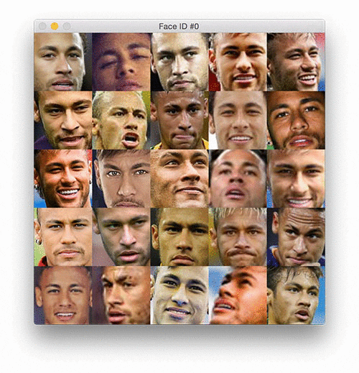
Outline
Introduction
Abstract
Motivation
Comparative Analysis on Existing Solutions
Methodology
Proposed Features
Key Technologies to be Used
Impact of the Proposed Work
References

Slide 3
Introduction
Generating synthetic images can be used to augment training datasets for face recognition algorithms, leading to more robust and accurate models.
It helps in handling scenarios with limited training data or dealing with variations in lighting conditions, poses, and expressions.
It Has Applications in Medical Imaging Research and Training, Forensics Investigations and Law Enforcement.
Generating realistic images can be used to augment datasets for training Deep Learning models.
By synthesizing additional data points, it helps in improving model performance, generalization, and robustness. This is particularly valuable when the original dataset is limited in size or lacks diversity.

Slide 4
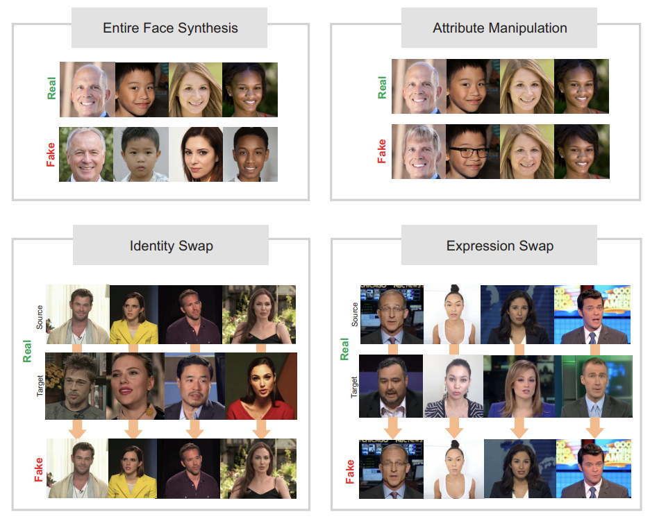
Introduction (Contd..)
Deep learning models typically requires a large amount of labeled data for training.
Data Augmentation techniques, such as generating synthetic images, help to increase the effective size of the training set by creating additional examples with realistic variations.
Few Examples of Real Images and Generated Images

Slide 5
Abstract
Generating realistic images of human faces from a dataset of facial images has been a challenging problem in computer vision and artificial intelligence.
This work aims to propose a deep learning approach based on a generative adversarial network (GAN) architecture for generating realistic images of human faces.
It is intended to develop a generative model capable of synthesizing high-quality and diverse human faces from a given dataset of facial images.
The proposed approach will be trained and evaluated using the CelebA dataset, which contains over 200,000 facial images of celebrities.

Slide 6
Motivation
Data Augmentation
Augmentation can improve the generalization and performance of models, enabling them to better handle real-world scenarios and variations.
Forensic Investigations
It aids in creating accurate representations of suspects or missing persons, potentially assisting law enforcement in identifying individuals and solving criminal cases.
Medical Imaging Research and Training
Realistic image generation has applications in medical research and training. It can be used to generate synthetic medical images and simulations for training medical professionals and students.
Forensic Investigations and Law Enforcement
Realistic image generation can aid in forensic investigations and law enforcement efforts. It can be used to generate age-progressed images of missing persons or suspects to assist in identifying them over extended periods.

Slide 7
Comparative Analysis on Existing Solutions
Deep Boltzmann Machines (DBMs) [1]: DBMs are generative models that consist of multiple layers of stochastic hidden units. They have been used for generating realistic human faces by training the model to learn the underlying distribution of facial images.
Style Transfer Techniques [2]: Style transfer techniques involve transferring the style of one image onto another image. By applying style transfer techniques to facial images, it is possible to generate new faces with a desired artistic style or characteristics.
Evolutionary Algorithms [3]: These can be used to evolve a population of facial images towards a desired target. By iteratively selecting, recombining, and mutating the best-performing individuals, realistic faces can be generated.
Disadvantages of Existing Methods:
Mode collapse occurs when the generator of a GAN fails to explore the full diversity of the target distribution and instead produces limited variations or repetitive outputs.
Many existing methods struggle with providing explicit control over specific attributes or characteristics of the generated faces.
The performance and quality of existing methods can be sensitive to the quality, diversity, and size of the training dataset.

Slide 8
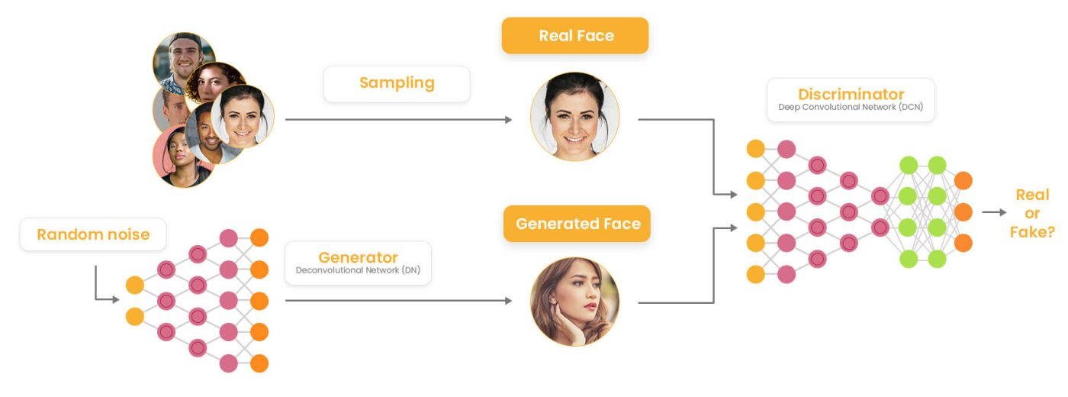
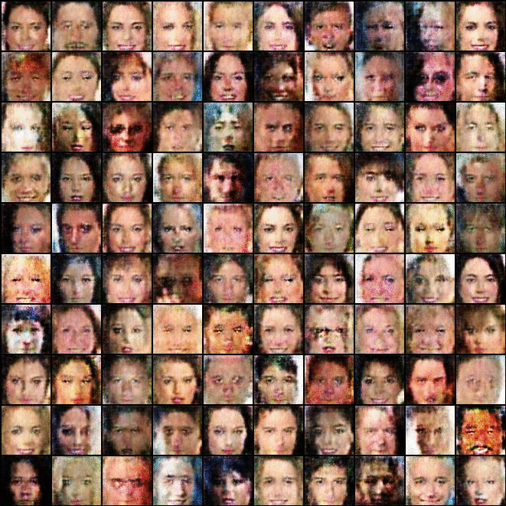
Methodology
Dataset: CelebA
A Brief Framework of the Proposed Model
Dataset Collection
Designing Network Architecture
Training the Network
Fine Tuning and Hyperparameter
Performance Evaluation
Generating New Images
Key Technologies to be Used
PyTorch
CNNs
Generative Adversarial Network
Google Colab/Jupyter
Total Images: 202599
Binary Attributes: 40
Dimensions: 512*512

Slide 9
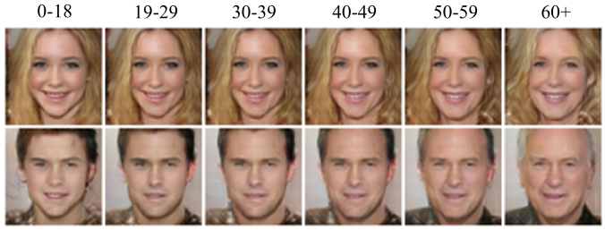
Impact of the Proposed Work
Realistic Image Generation
Age Progression and Regression
Increased Flexibility
Enhanced Realistic Nature of Images

Slide 10
References
L. Minh Dang, Kyungbok Min, Sujin Lee, Dongil Han, Hyeonjoon Moon, “Tampered and Computer-Generated Face Images Identification Based on Deep Learning”, Applied Sciences, Vol, 10, Issue 2, 2020. URL : https://www.mdpi.com/2076-3417/10/2/505
Peizhen Lin, Baoyu Liu, Lei Wang, Zetong Lei, Jun Cheng, “Face Translation based on Semantic Style Transfer and Rendering from One Single Image”, in the Proceedings of 2021 10th International Conference on Software and Computer Applications, Malaysia, February 2021. URL: https://dl.acm.org/doi/fullHtml/10.1145/3457784.3457811
Benjamín Machín, Sergio Nesmachnow, Jamal Toutouh,“Multi-target evolutionary latent space search of a generative adversarial network for human face generation”, in Proceedings of the Genetic and Evolutionary Computation Conference Companion, July 2022. URL: https://dl.acm.org/doi/10.1145/3520304.3533992

Slide 11
THANK YOU

